Slide 1

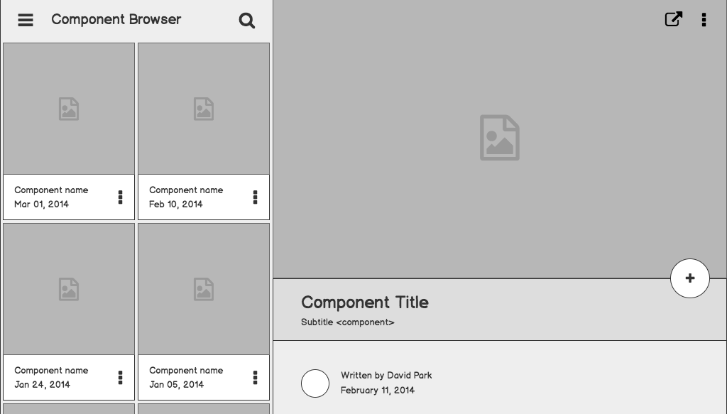

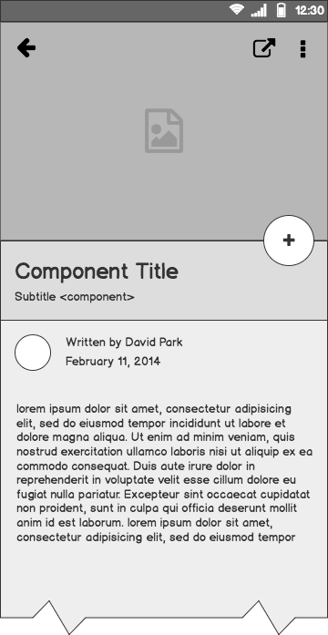
Causal Inference and AB Testing
Raja Harsha Chinta
Norfolk Data Science Meetup
June 18, 2019

Slide 2
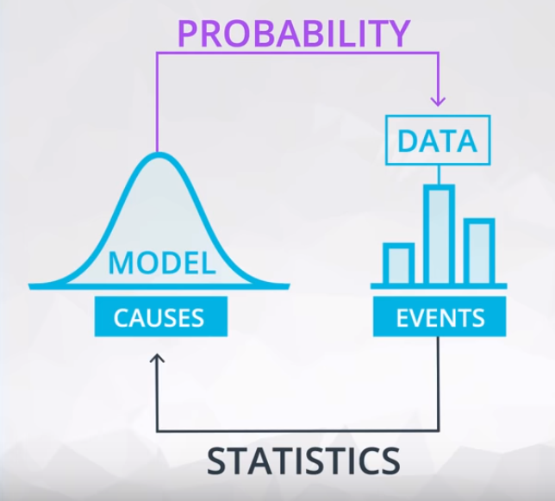
Probability & Statistics
Probability is used to make prediction of future events.
Statistics is used to analyze events to understand the causes.

Slide 3
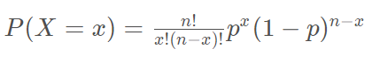
Binomial Distribution
Probability of a string of independent events with two outcomes each.
Ex: Probability of 3 heads occurring in 10 flips.
Shows up in a lot of modeling techniques and explain outcome with 2 possible events. Example: Logistic Regression
Where..
n is number of “events”
x is the number of “successes”
p is the probability of “success”

Slide 4
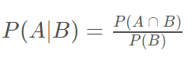
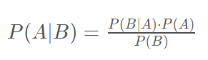
Conditional Probability
Often events are not independent and outcome of one event depends on an earlier event.
Bayes Rule: Describes the probability of an event, based on prior knowledge of conditions that might be related to the event.

Slide 5
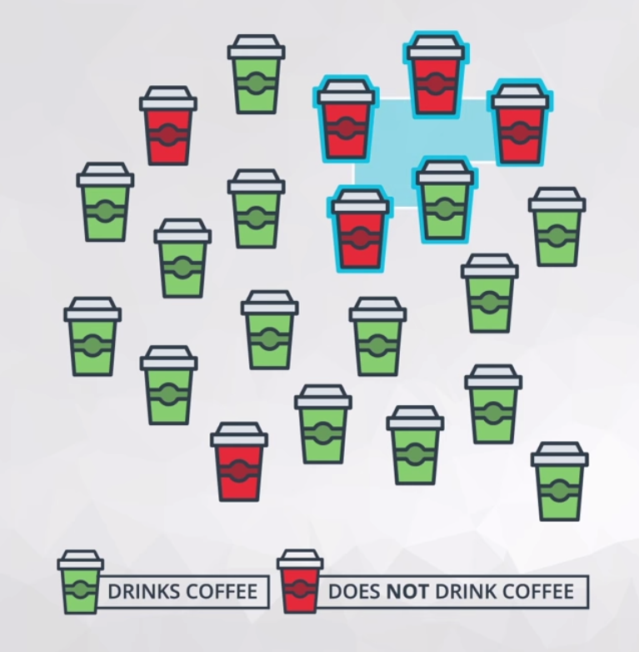
Metrics
Population - 21 Students
Sample - 5 Students
Statistic - 20% Drink Coffee
Parameter - 71% Drink Coffee

Slide 6
Descriptive and Inferential Stats.
Example: A survey conducted across 100,000 students(Population) where only 5000 responded(Sample) out of which 73%(Statistic) of responded that they will drink coffee.
Any information we explain about these 5000 responses is Descriptive statistics.
Information that we conclude from the Sample data towards the Population is Inferential statistics.

Slide 7
Normal Distribution
Where..

Slide 8
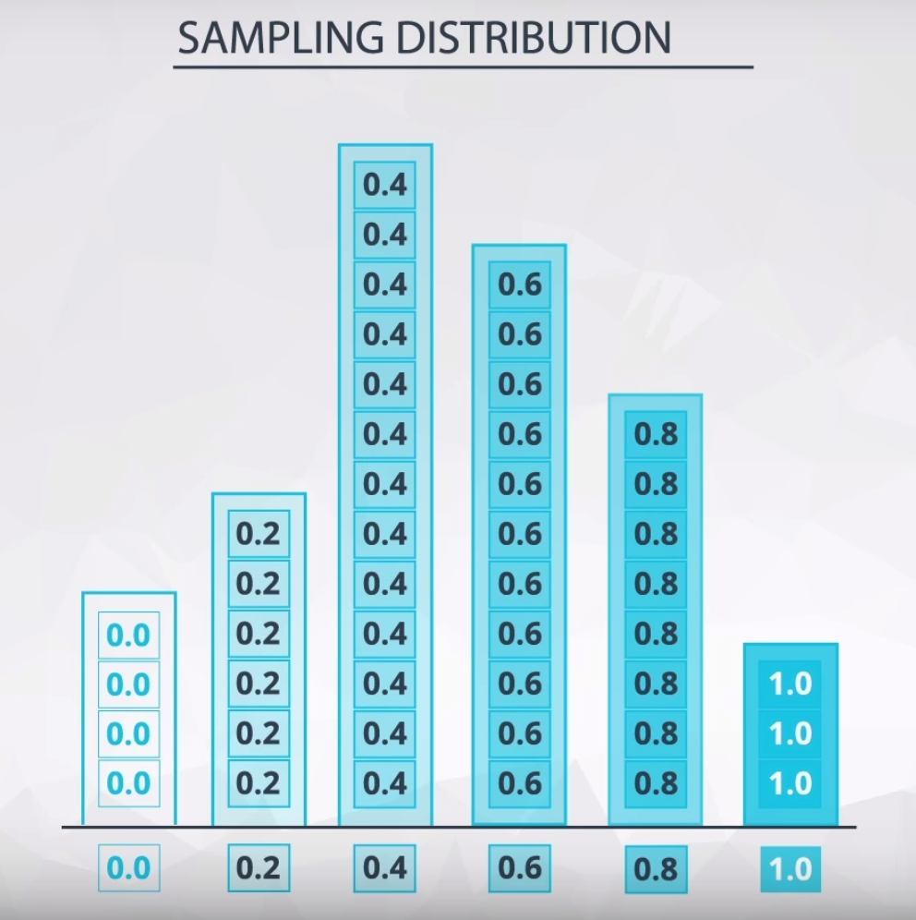
Sampling Distribution & Bootstrapping
Sampling Distributions are the distribution of a statistic. There are imp. methods below.
Bootstrapping is a technique where we sample from a group with replacement to simulate the creation of sampling distribution and gain more understanding of statistic.
Used in Random Forest’ and ‘Stochastic Gradient Descent.’

Slide 9
Confidence Intervals
How do we use sample distributions to infer the parameter value?
By finding the statistic that best estimates our parameter of interest (sample mean here) and creating a sampling distribution we can build a confidence interval.
Bootstrapping is the most effective method for sampling and calculating CI.

Slide 10
Hypothesis Tests
Hypothesis Testing and Confidence Intervals allow us to use only sample data to draw conclusions about entire population.
p-value is the probability of observing your statistic if the null hypothesis is true.
H0 ​ is true before you collect any data.
H1​ is what we would like to prove to be true.

Slide 11
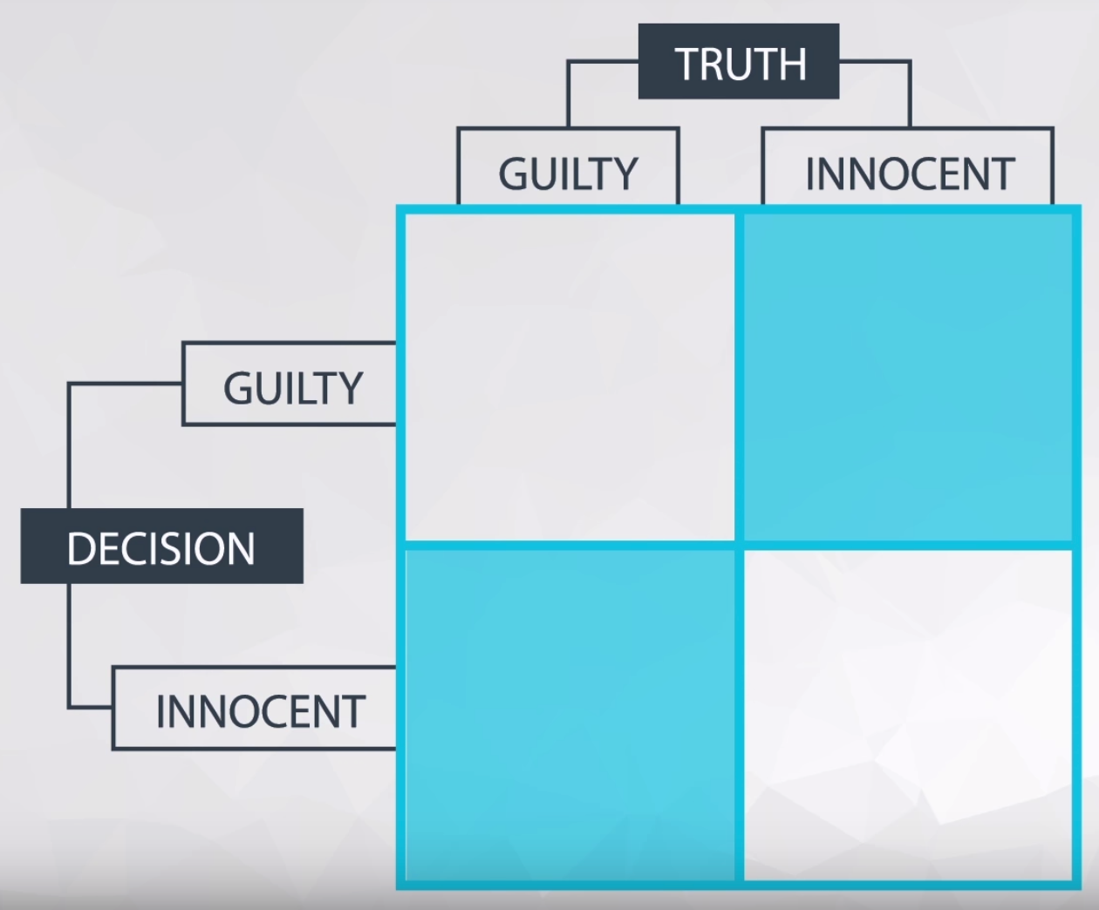
Test Errors
Type I errors - False Positives
Deciding Alternative Hypothesis is True when Null Hypothesis is True
Type 2 errors - False Negatives
Deciding Null Hypothesis is True when Alternative is True.

Slide 12
A/B Test
A/B tests are used to test changes on a environment by running an experiment where:
A control group sees the old version, while the experiment group sees the new version.
A metric is then chosen to measure the level of engagement from users in each group.
A/B testing is very much like hypothesis testing with the following hypotheses:
Null Hypothesis: The new version is no better, or even worse, than the old version
Alternative Hypothesis: The new version is better than the old version

Slide 13
Drawbacks
Novelty effect and change aversion when existing users first experience a change.
Require sufficient traffic and conversions to have significant and repeatable results.
Sometimes require long duration of experimentation due to seasonal changes.
Practical significance of a conversion rate (the cost of launching a new features vs gain).
Consistency among test subjects in the control and experimental group (Simpson’s Paradox).

Slide 14
References
https://uxdesign.cc/how-netflix-does-a-b-testing-87df9f9bf57c
https://kojinoshiba.com/causal%20inference/theory-behind-ab-testing/
https://conversionsciences.com/ab-testing-statistics/
https://www.udacity.com/course/data-analyst-nanodegree--nd002

Slide 15
Thank you

